Slide 1
The Role of Judges in Determining the Meaning of Religious Symbols
Religious Freedom Discussion Series
October 27, 2011
Professor Brett G. Scharffs
Part 2

Slide 2
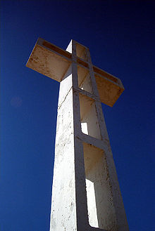
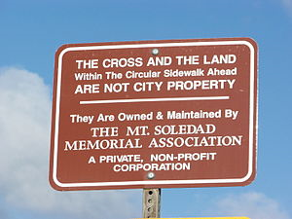
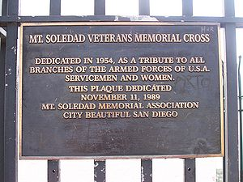
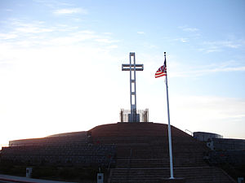
Mount Soledad Cross Case
Trunk v. City of San Diego (9th Cir., 2011)

Slide 3
Trunk v. City of San Diego (9th Cir., 2011) Description
In January 2011, the Ninth Circuit Court of Appeals held that the cross was an unconstitutional establishment of religion. Judge McKeown wrote for the court, "Overall, a reasonable observer viewing the Memorial would be confronted with an initial dedication for religious purposes, its long history of religious use, widespread public recognition of the Cross as a Christian symbol, and the history of religious discrimination in La Jolla."
9th Circuit concluded that the monument “primarily conveys a message of government endorsement of religion.”

Slide 4
Trunk v. City of San Diego (9th Cir., 2011) Analysis
Classic example of a court exercising its “world maintaining” jurispathic role.
By declaring definitively what the monument means, the court discounts and discredits other meanings, and converts the symbol into something even more divisive than it was before.

Slide 5
Trunk v. City of San Diego (9th Cir., 2011) Analysis:
No longer can critics look at the monument and say, “well at least it is just, or at least partly, a war memorial.”
Proponents of the monument have had something important to them removed based upon an interpretation of its meaning with which they may strongly disagree.

Slide 6
Trunk v. City of San Diego (9th Cir., 2011) Update:
October 14, 2011: 9th Circuit denied motion for rehearing and rehearing en banc
Judge Bea (writing for five other judges) dissented
Quoted Gertrude Stein, “A Rose is a rose is a rose.”
“Stein wrote this sentiment to express the flower’s indescribable, unchangeable essence. The panel appears to have transmogrified Stein’s ode to a rose into a new rule of law – “a cross is a cross is a cross.” Alas, that is neither good poetry nor valid law. Unlike roses, religious symbols can have multiple meanings, just as the Ten Commandments monument did in Van Orden. __ F.3d __ (Oct. 14, 2011)

Slide 7
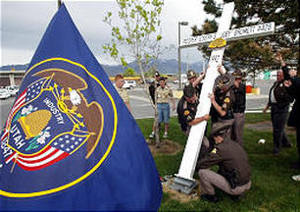
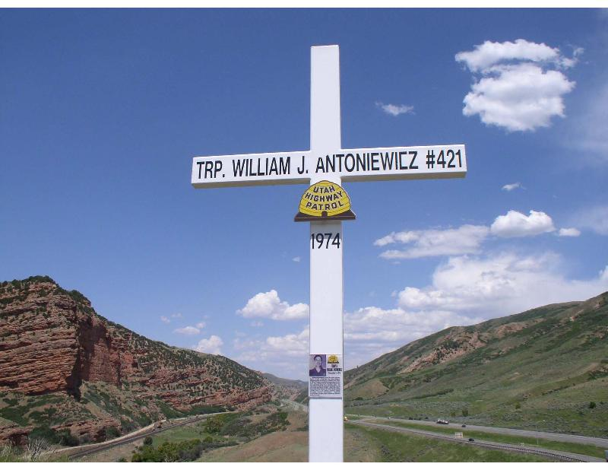
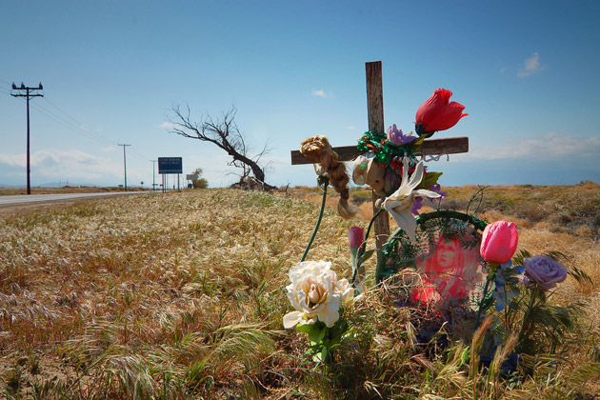
U.S. (10th Cir) Utah State Trooper Monuments

Slide 8
American Atheists, Inc. v. Lance Davenport (10th Cir., 2010)
Another example of jurispathic courts making superficial declarations about what symbols mean:
"We hold that these memorials have the impermissible effect of conveying to the reasonable observer the message that the state prefers or otherwise endorses a certain religion.”
“Reasonable observer”
“Endorsement”

Slide 9
American Atheists, Inc. v. Lance Davenport (10th Cir., 2010)
Update:
State of Utah filed petition for certiorari in April, 2011
American Atheists, Inc., and Utah Civil Rights & Liberties Foundation filed brief in opposition in July, 2011
As of October 2011, petition is pending

Slide 10
ECHR: French and Turkish Headscarf Cases
Sahin v. Turkey (ECHR Grand Chamber, 2005)
The court does not clearly explain what the headscarf means, but they speculate that it is coercive to women:
“. . . When examining the question of the Islamic headscarf in the Turkish context, there must be borne in mind the impact which wearing such a symbol, which is presented or perceived as a compulsory religious duty, may have on those who choose not to wear it . . . . In a country in which the majority of the population, while professing a strong attachment to the rights of women and a secular way of life, adhere to the Islamic faith.”

Slide 11
ECHR: French and Turkish Headscarf Cases
Sahin v. Turkey (ECHR Grand Chamber, 2005)
Another example of court exercising its jurispathic function.
Very questionable assumptions / conclusions about what the headscarf means.
Symbol of gender inequality
Coercive effect on others to wear the headscarf
Wearing it is based upon misunderstanding of Islam and religious obligation
What equality requires

Slide 12
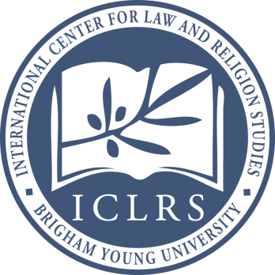
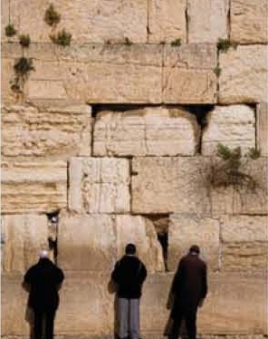
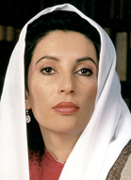
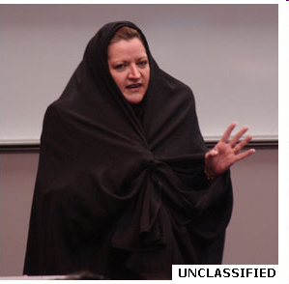
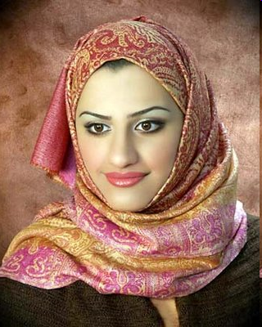
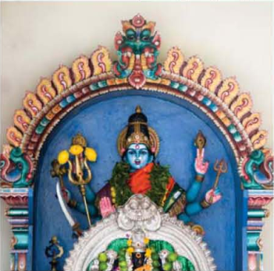
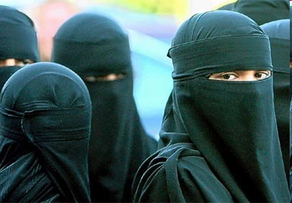
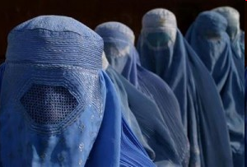
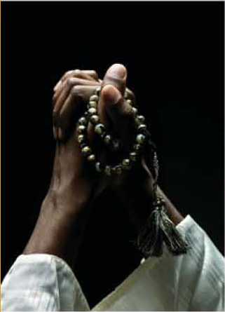
The Jurisgenerative and Jurispathic Faces of the Law

Slide 13
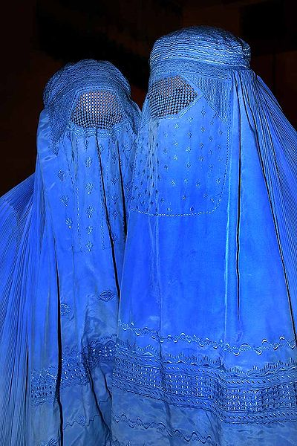
The “Shuttlecock” Burqa
http://en.wikipedia.org/wiki/File:Burqa_Afghanistan_01.jpg

Slide 14
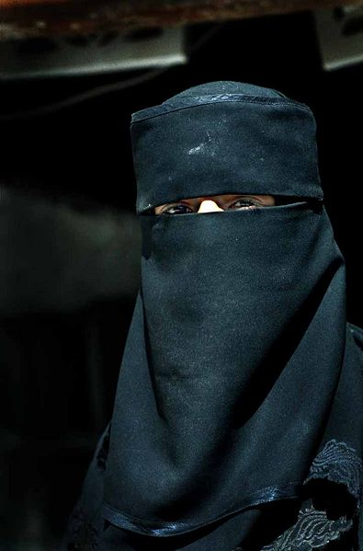
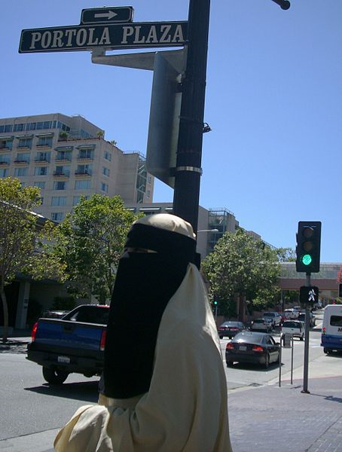
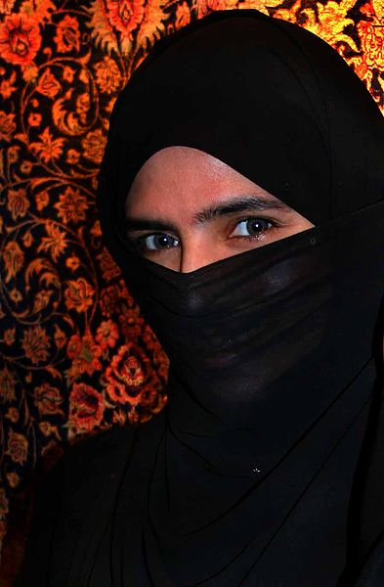
The Niqab
http://en.wikipedia.org/wiki/Niqab

Slide 15
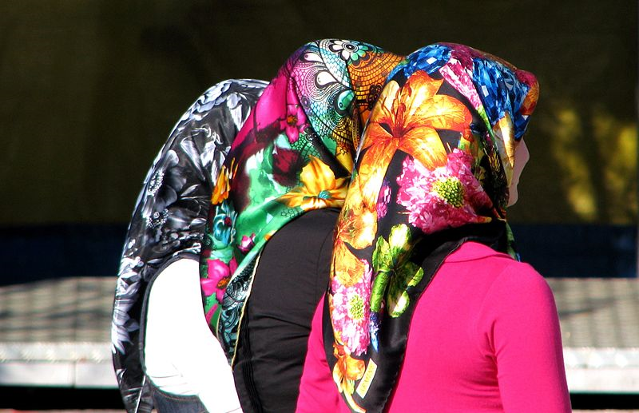
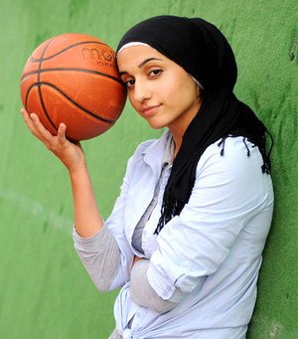
Sporty / Fashionable Headscarves
http://www.interbasket.net/news/3568/2009/08/muslim-basketballer-forbidden-to-wear-headscarf

Slide 16
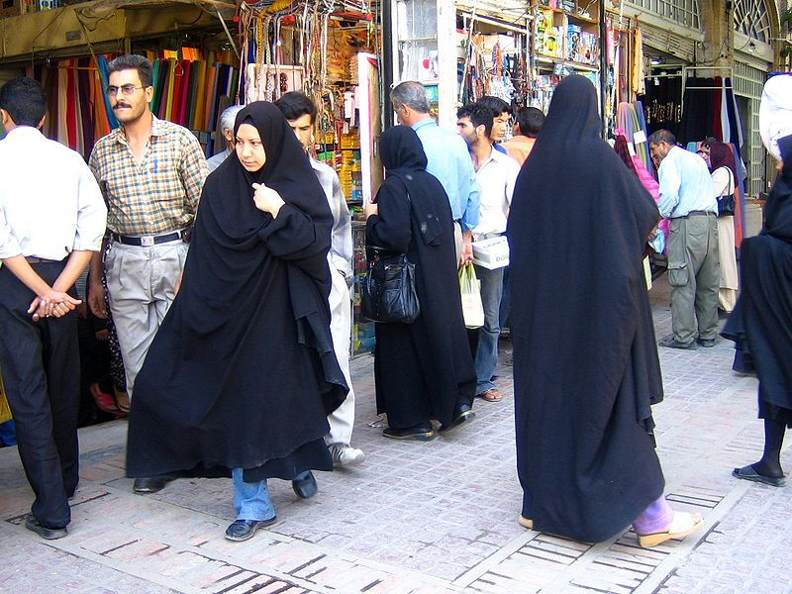
Chador
http://en.wikipedia.org/wiki/File:Women_in_shiraz_2.jpg

Slide 17
Other Head Coverings
Tendency to think of head coverings as an Islamic Issue –
This is not only an over simplification, it is inaccurate
Recent Kenyan school case, involving Christian group: court forbade the head coverings and followed reasoning of ECHR in French headscarf case

Slide 18
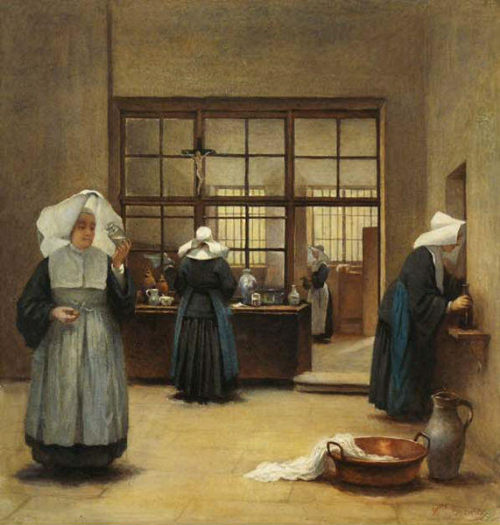
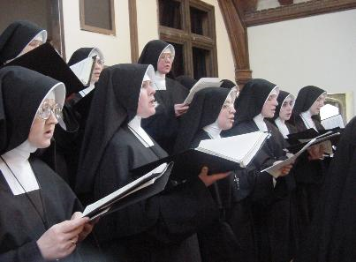
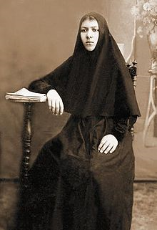
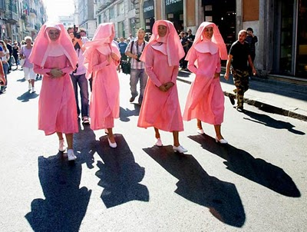
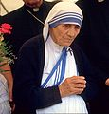
Nuns

Slide 19
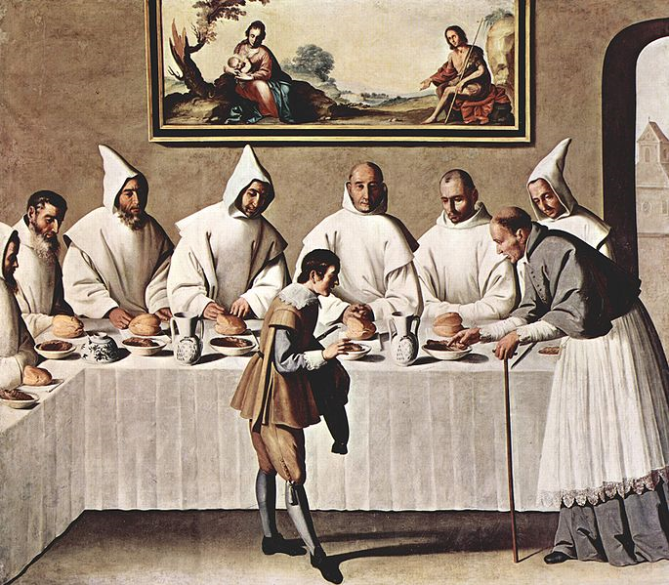
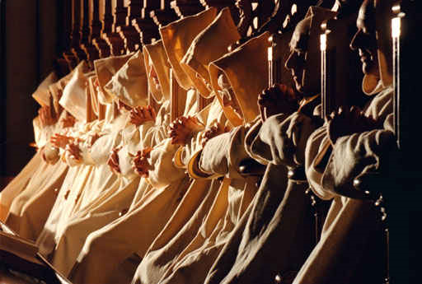
Carthusian Cowl
http://en.wikipedia.org/wiki/Carthusians
http://fatherdavidbirdosb.blogspot.com/2011/01/beyond-silence-carthusian-monks-speak.html

Slide 20
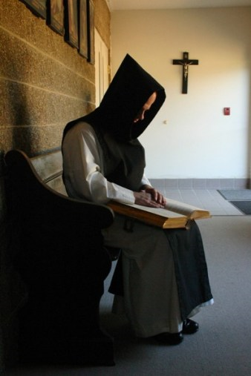
Augustinian Monks
http://catholicismpure.wordpress.com/2011/01/27/lectio-divina-verbum-domini

Slide 21
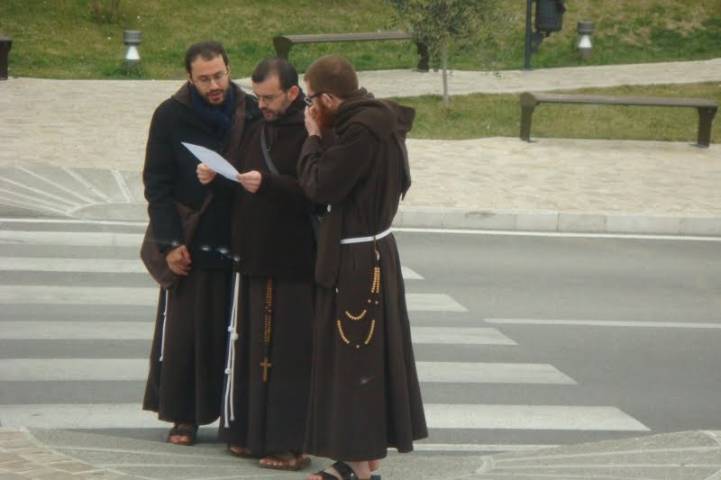
Franciscan Monks

Slide 22
Koukoulian (Eastern Orthodox)
http://www.kreuzgang.org/viewtopic.php?f=21&t=8923

Slide 23
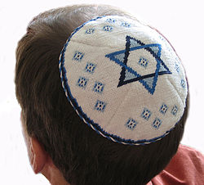
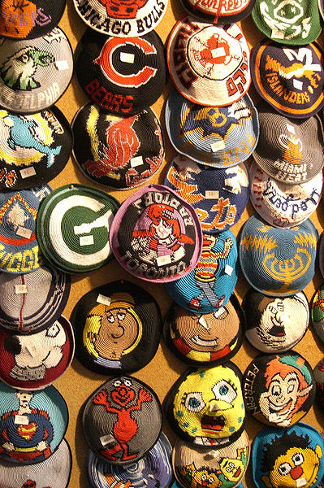
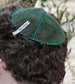
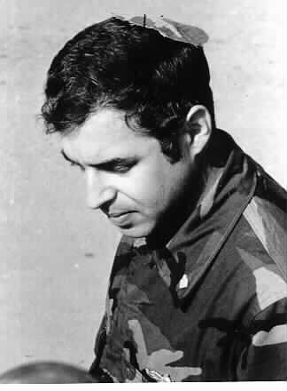
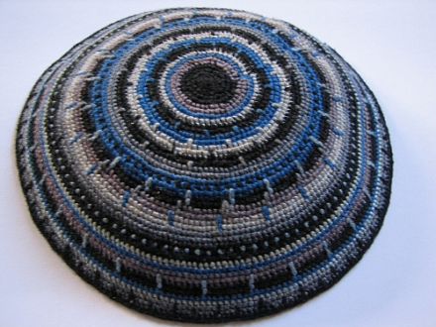
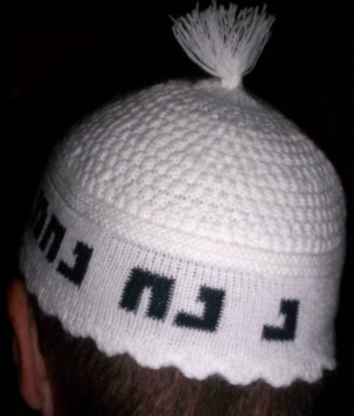
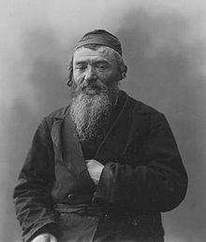
Jewish Skull Cap / Kippa
Chaplain Arnold Resnicoff, wearing the make-shift "camouflage kippa" made for him by Catholic chaplain (Fr.) George Pucciarelli, after his had become bloodied when it was used to wipe the face of a wounded Marine, Beirut, 1983.
http://en.wikipedia.org/wiki/Kippa#Head_coverings_in_ancient_Israelite_culture

Slide 24
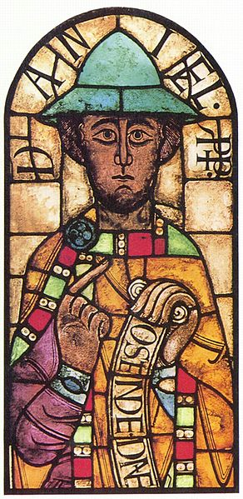
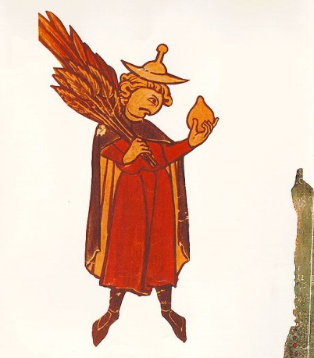
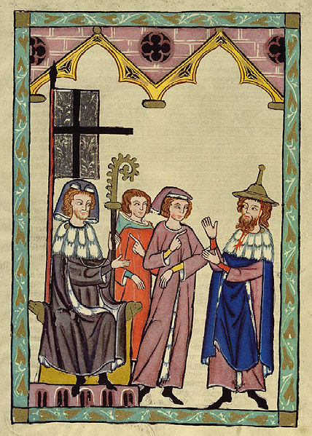
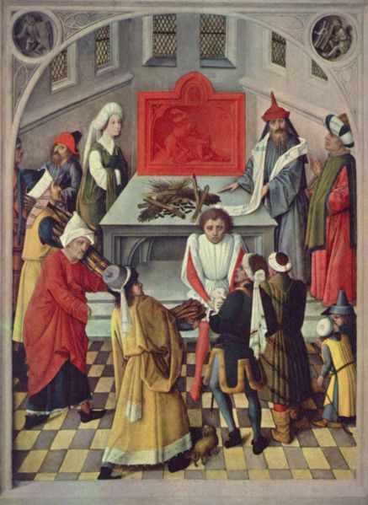
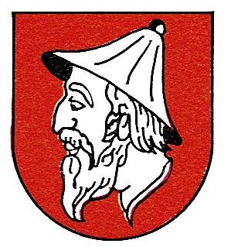
Other Jewish Hats

Slide 25
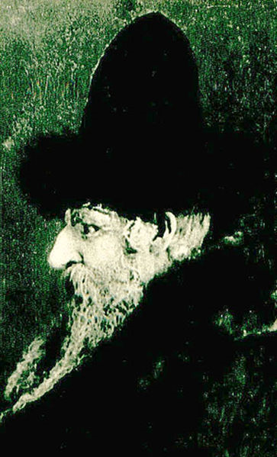
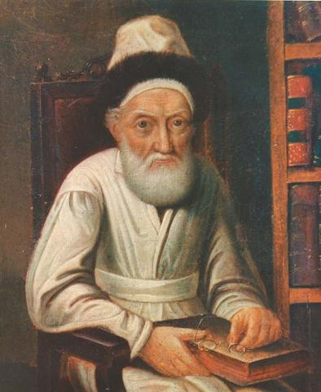
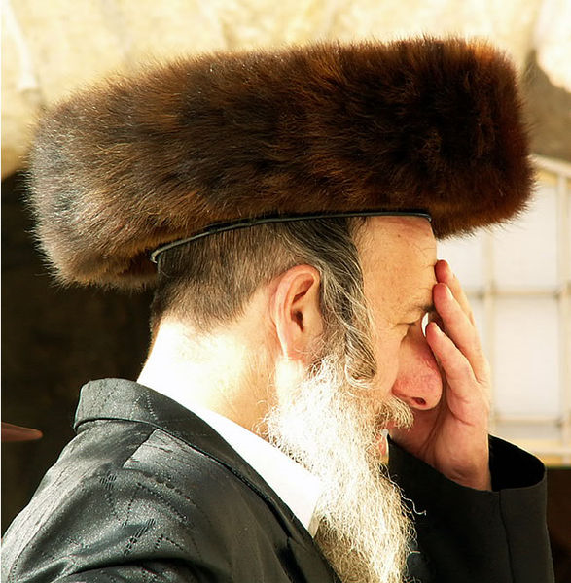
Shtreimel (Hasidic Jew)

Slide 26
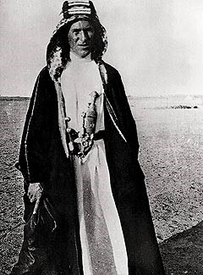
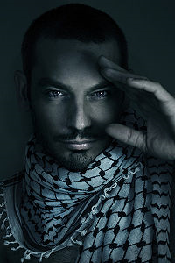
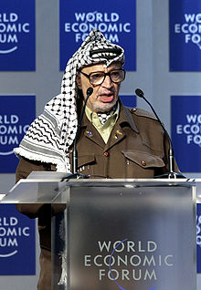
Keffiyeh

Slide 27
Academic Dress

Slide 28
Surprising that Court was so quick to draw conclusions about what the headscarf symbolizes
Obedience
Modesty
Submission to God
Voluntary
Obligatory
Autonomy
Heteronomy
Submission to husbands / father
Inequality
Oppression
Courage
Protest

Slide 29
Example of Judges Adopting
Jurisgenerative Approach
Jurisgenerative Approach: The ECtHR’s in the Italian Classroom Crucifix Case (Lautsi)

